Slide 1
The NLC Multistate License:
An Overview
NJSNA/IFN Annual Conference
October 17, 2025
Jim Puente, MS, MJ, CAE
Director, NLC
Notes:
Main Slide: Option 1
For title and speaker name

Slide 2
Definitions
Multistate License or Compact License: one license issued in the primary state of residence, valid for practice in all NLC states
Party State: any NLC state
Single-state License: valid only in state of issuance
Primary State of Residence (PSOR): the state of legal residency
Remote States: NLC states other than the home state
Privilege to Practice (PTP): the authority for a multistate license holder to practice in other NLC states
For the full definitions list, visit: nursecompact.com/files/nlc_definitions.pdf

Slide 3


What IS the Nurse Licensure Compact?
A statutory agreement in the form of state legislation between two or more states established for the purpose of remedying a particular problem of multistate concern.
A multistate license is NOT a national license; it is a state-based license.
The NLC allows for a nurse (RN and LPN/VN) to have one multistate license (issued from his/her primary state of residency.)
The NLC permits the nurse to practice in other compact states (physically or via telehealth) subject to each states’ laws.

Slide 4
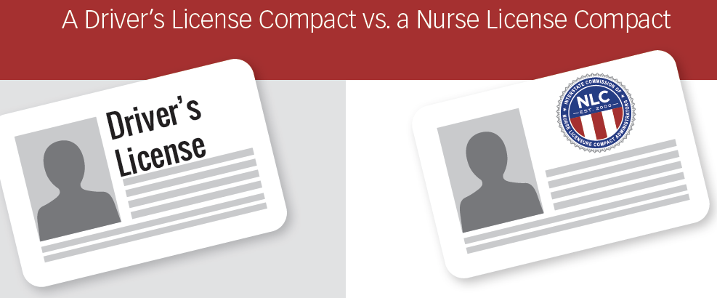
Mutual Recognition Model of Licensure
The NLC was originally developed based on the Driver’s License Compact (DLC).
It shares the same concept of one multistate license issued in the Primary State of Residence (PSOR) and accepted in all member states.
You can drive across state lines with one license because other states are members of the driver’s license compact. They accept the license of your PSOR.

Slide 5
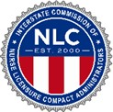
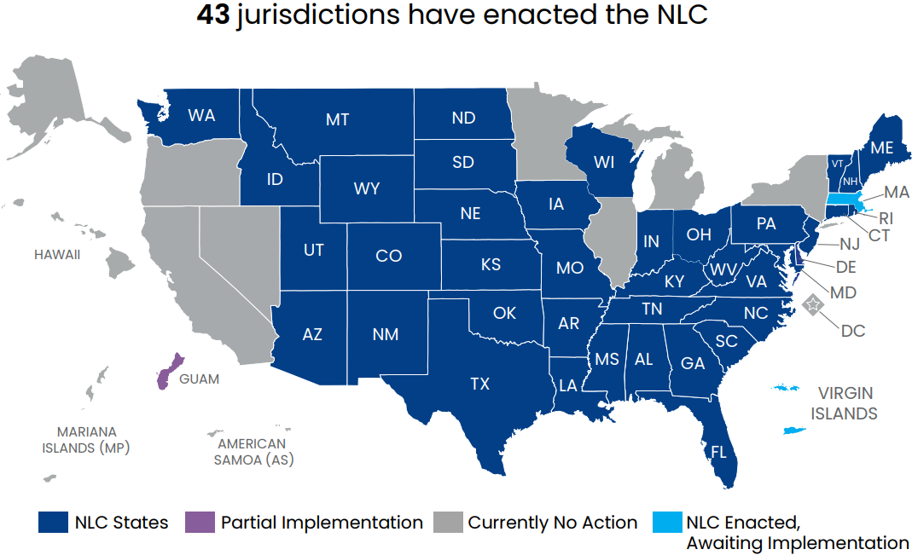
Which States are Members of the NLC?
For details, see: www.nursecompact.com/files/NLC_Map.pdf

Slide 6
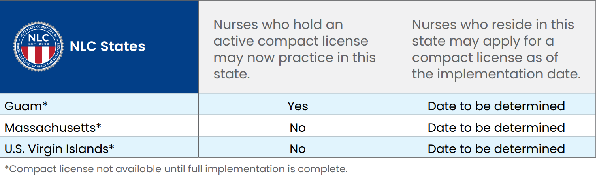
Implementation Status
For details, see: www.nursecompact.com/files/NLC_Map.pdf

Slide 7

Primary State of Residence (PSOR) is Key!
The compact license is issued based on your primary state of permanent residency for legal purposes.
This is the state which issued your driver’s license and where
you are registered to vote.
If you change your primary state of residence, then you are required
by law to get a new driver’s license in your new state; you would
register to vote in the new state as well.
The same process applies to the nurse compact license.
Should you change your PSOR, you must get a new compact license
in the new state of residency.

Slide 8
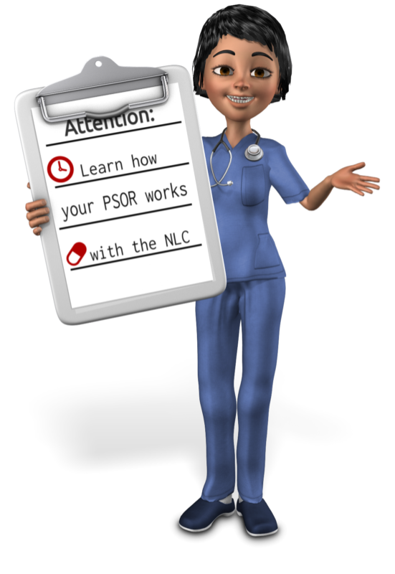
What is my PSOR?
PSOR is the state where you can prove you legally reside. It is the state from which you have your Driver’s License, voter registration card, and state declared on your federal tax filing.
Residency does NOT pertain to home or property ownership.
There can only be ONE PSOR.
All of your legal documentation should be in that one PSOR.

Slide 9


My State Joined the NLC –
How do I Obtain a Multistate License?
If you are a legal resident of a NLC state that joined the NLC after 1/19/2018 (GA, FL, OK, WY, WV, KS, AL, LA, NJ, OH, IN, NJ, PA, CT) and hold a single state license in that state…
Go to the board of nursing website
Complete the upgrade (or conversion) application

Slide 10
NLC Rule - Changing PSOR (Permanent Relocation)
As of Jan. 2, 2024
Rule 402 (2) A multistate licensee who changes primary state of residence to another party state shall apply for a multistate license in the new party state within 60 days.

Slide 11
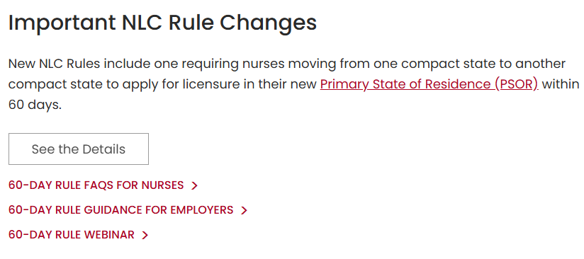
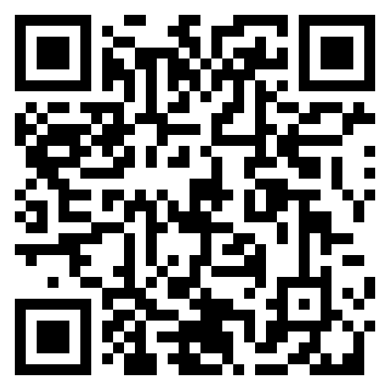
60-Day Rule Resources on the NLC Website

Slide 12
Rule 403
Change in Primary State of Residence (PSOR)
A nurse who changes his or her primary state of residence from one party state to another party state may continue to practice under the existing multistate license while the nurse’s application is processed and a multistate license is issued in the new primary state of residence.
Upon issuance of a new multistate license, the former primary state of residence shall deactivate its multistate license held by the nurse and provide notice to the nurse.

Slide 13
How Can Employers Ensure Nurses Hired from NLC States Hold the Correct License?
Check the license status on www.nursys.com using the Quick Confirm feature.
Determine if the nurse is changing the PSOR or not. Is the nurse moving and becoming a resident of your state (or perhaps of an adjacent state, if the job is near state lines)? Is the nurse only in your state temporarily and then returning home?
The nurse changing PSOR must apply for license by endorsement upon moving.
The nurse not changing PSOR will practice in your state under her existing multistate license. I.e., The nurse’s intent is to return to her home state /PSOR.
Employers often implement a policy by which nurses who need to apply for license by endorsement, do so and provide proof within X number of days, e.g., 10 days.

Slide 14
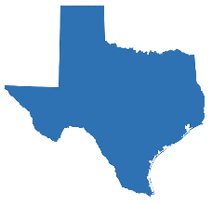

Changing PSOR from NLC State to NLC State
Nurse Jones is a resident of Texas, holds an active Texas multistate license (MSL), and is relocating from Texas to Ohio, which will be his new primary state of residence.
Nurse Jones has 60 days from the time he arrives in Ohio to apply for license by endorsement with the Ohio Board of Nursing to obtain an Ohio MSL.
Nurse Jones may practice in Ohio under the active Texas MSL until the Ohio MSL is issued, at which time the Texas license is deactivated.
Nurse Jones should no longer renew the Texas license once he relocates to Ohio.
Question: Since her Texas compact license does not expire for 18 months after relocating to Ohio, can she just wait until expiration before applying for an Ohio license? No, she must apply within 60 days.

Slide 15


Travel Nurse Example
Nurse Smith is a legal resident of Arizona, holds an active Arizona multistate license (MSL), and is traveling to Kentucky for a 13-week travel nurse assignment.
Nurse Smith will practice in Kentucky under her Arizona MSL. She will not need to obtain a Kentucky license because she is not becoming a legal resident of Kentucky.
Nurse Smith is working in Kentucky temporarily and is maintaining Arizona as her primary state of residence for legal purposes, as she will return to Arizona.

Slide 16
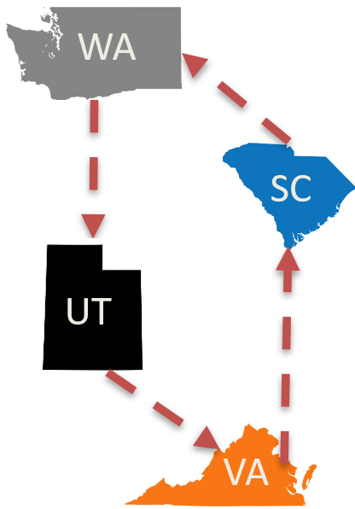
Military Spouse Example
Nurse Brown is a military spouse and a legal resident of Washington, her home state, where she holds an active Washington multistate (MSL) license.
Her spouse received military orders to be in Utah for three years. She will practice at a civilian hospital in Utah under her Washington MSL. She will not need to obtain a Utah license because she is not becoming a legal resident of Utah; she and her family are only living there temporarily for military purposes.
Nurse Brown is maintaining Washington as her primary state of residence for legal purposes throughout successive military moves. She will continue to practice under her Washington MSL when the family is based in Virginia three years later, then South Carolina for three years, etc.

Slide 17
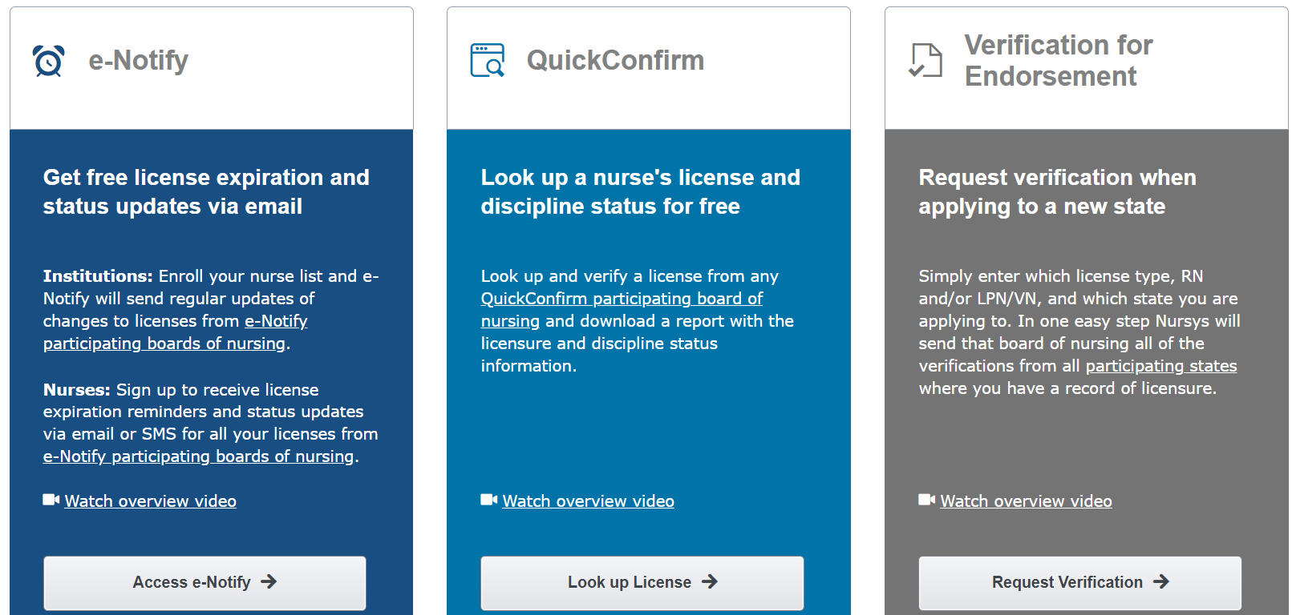
Nursys®

Slide 18
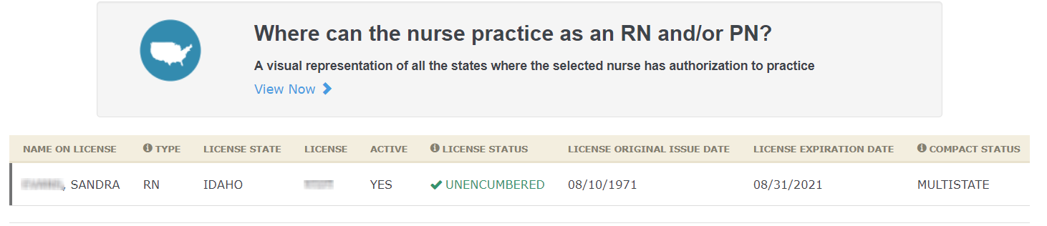
Nursys QuickConfirm

Slide 19
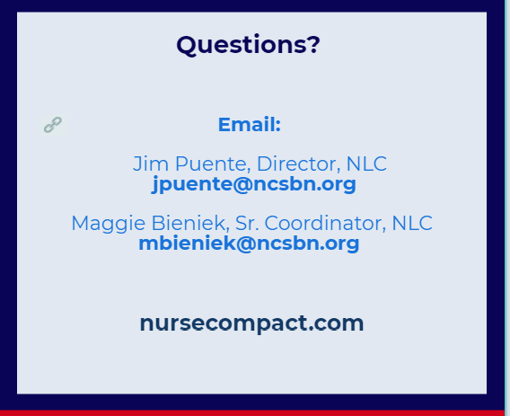
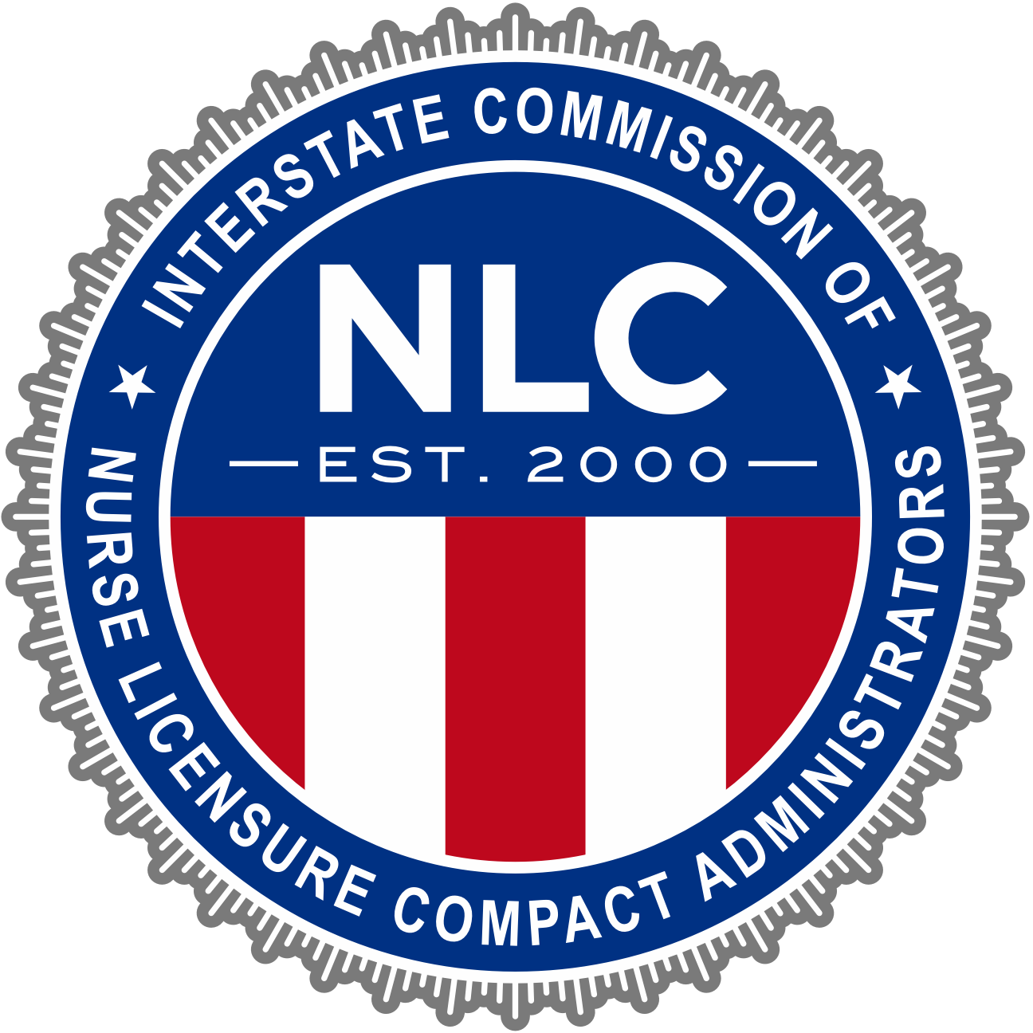
THANK YOU!
Email:
nursecompact@ncsbn.org
Website:
NLC.gov

